Slide 1


Master of Applied Computing: Internship Project I
Team:
Abhishek Jitendra Mehta
Ashish Narendrakumar Patel
Hardikkumar Jayantilal Makwana
Networking and Data Security Final Project Presentation
Mitnick Attack

Slide 2

Introduction
Kevin Mitnick was the biggest hacker of his time and probably the most well-known hacker in history.
In 1994 Kevin Mitnick successfully launched an attack on Tsutomu Shimomura's computer.
Shimomura was a computer security expert who worked with the San Diego super-computer center.
This attack is more popularly known as Mitnick Attack.

Slide 3

What is Mitnick attack?
The Mitnick attack is a form of TCP session hijacking in which vulnerabilities in the TCP protocol and the trust between two machines are exploited.
The Mitnick attack establishes a TCP connection between victim client and victim server on their behalf and then naturally hijacks it.
By sniffing the packets exchange for establishing the connection, Mitnick was able to deduce X-TCP Terminal's sequence number generator behavior as well as the existence of a trusted relationship between X-Terminal and Server.
Then it masquerades as Server and gets access to client's machine with rsh and implants a backdoor so that it can access the client any time it wants, by corrupting .rhosts file.

Slide 4
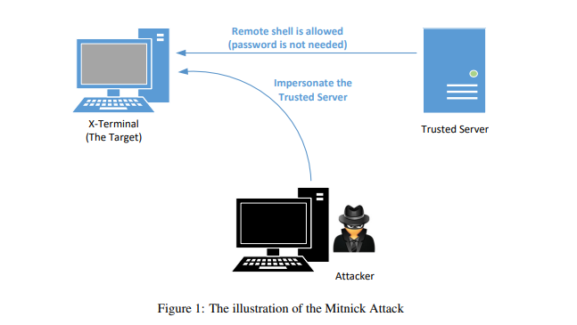
Mitnick Attack
There are 3 machines in play
X-Terminal (Victim)
The Server
The Attacker
Mitnick wanted to access X-terminal remotely and add a backdoor.
The server can access X-terminal without password due to trusted relationship between them

Slide 5

Steps of the Attack
Step 1: Sequence number prediction
To recognize a pattern for initial sequence numbers (ISN) is crucial to plan the attack.
Mitnick had send a SYN request to the victim client machine and received its SYN + ACK response.
Then he send a RESET packet to X-Terminal, to clear the half-open connection from X-Terminal’s queue.
Repeating this 20 times Mitnick discovered pattern between two successive TCP ISNs.

Slide 6
Steps of the Attack
Step 2: SYN flooding attack to silence the trusted server
Mitnick wanted to send a SYN message, masqueraded as the trusted server to X-Terminal, to which the victim client would send a response to the Server.
This would trigger the server to send a RESET message, since it never requested a connection, and to avoid this, Mitnick performed a SYN flooding attack to silent the server.
Operating systems were significantly more vulnerable to the SYN flooding attack back then. The attack had the potential to entirely silence the trusted machine.

Slide 7
Steps of the Attack
Step 3: Spoofing the TCP connection
Mitnick wanted to connect to the victim client using rsh, bypassing authentication step.
Shimomura, the victim user, had configured relation between the X-Terminal and trusted server, such that server didn’t require to provide password to gain remote access to the X-terminal.
Mitnick wanted to exploit this trusted relationship by masquerading as server, gaining access to the X-Terminal, and implanting a backdoor for his machine so he can attack anytime.

Slide 8
Steps of the Attack
Step 3: Spoofing the TCP connection ( ..Continued)
Mitnick required to establish a TCP connection between the Server and X terminal, to run rsh in this connection.
He send a SYN message with source IP of server, to which X terminal would respond to by sending SYN + ACK message to the server which is down due to step2.
From step 1, Mitnick already predicted the ISNs of SYN+ACK message of X terminal to the server and hence he could successfully spoof the ACK message to the X-terminal acting as server and complete the TCP 3-way handshake.

Slide 9
Steps of the Attack
Step 4: Running rsh and implanting backdoor
Now the TCP connection between Mitnick(acting as server) and X Terminal is established,
Mitnick will initiate a rsh connection to X-Terminal and will access its remote shell.
Then, to implant the backdoor, he will have to just update the .rhosts file on X-Terminal with “+ +”, and since rsh and rlogin program used .rhosts file for authentication, with this enhancement, X-Terminal would accept any rsh or rlogin request.

Slide 10
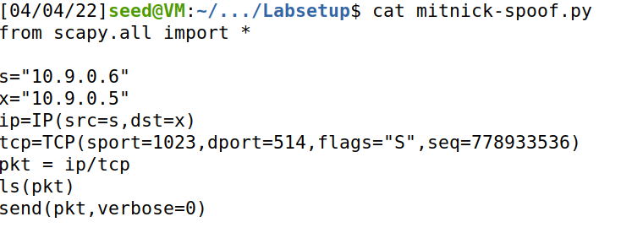

Mitnick Attack Demo

Slide 11
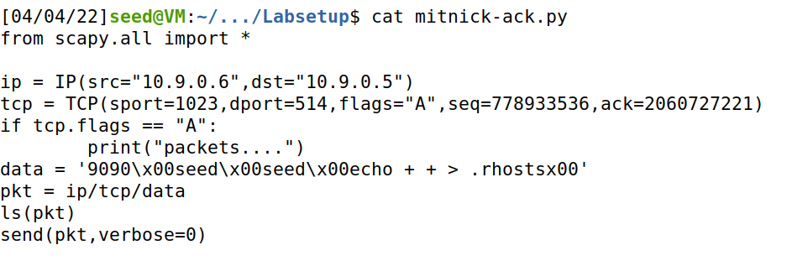

Mitnick Attack Demo

Slide 12
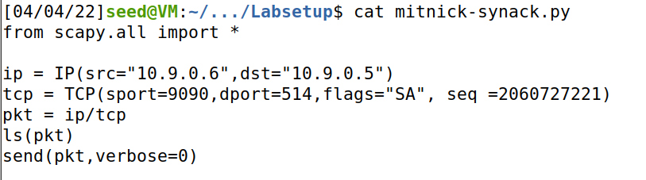
Mitnick Attack Demo

Slide 13
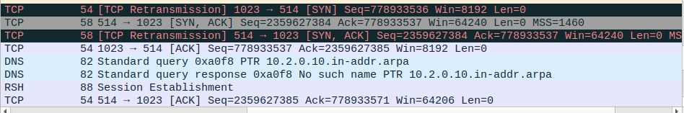
Mitnick Attack – 1st TCP Connection

Slide 14
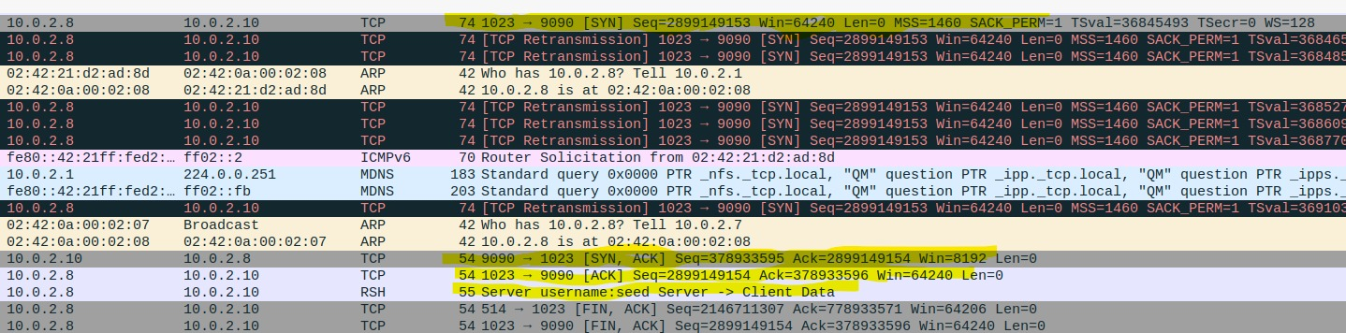
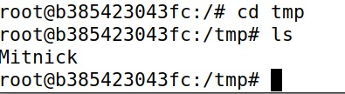
Mitnick Attack – 2nd TCP connection

Slide 15
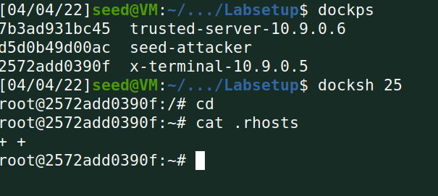
Mitnick Attack Demo

Slide 16
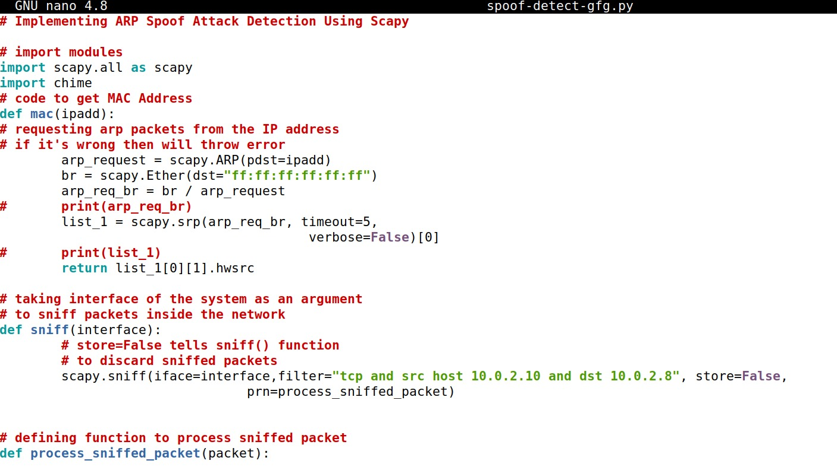
Mitnick Attack - Detection

Slide 17
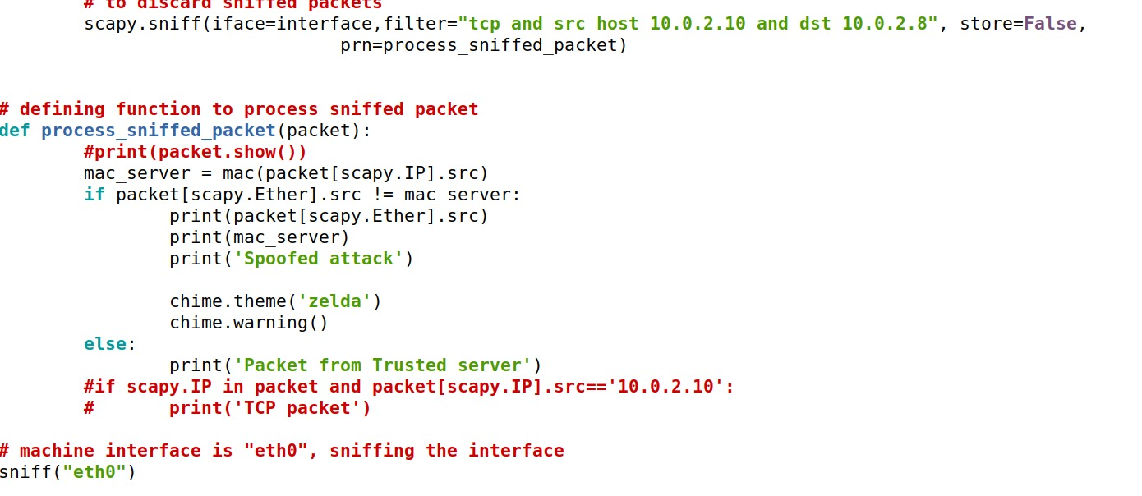
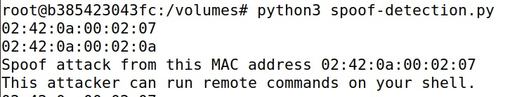
Mitnick Attack - Detection

Slide 18
Group members and contribution
Name | Id | Contribution
Hardikkumar Jayantilal Makwana | 110032202 | Research on Mitnick Attack, Hijacking TCP session of victim client and server (TCP three way handshake)
Ashish Narendrakumar Patel | 110053138 | Research on Mitnick Attack, Gaining access to victim’s remote shell (To run command on victim’s machine)
Abhishek Jitendra Mehta | 110035323 | Research on Mitnick Attack, Detection of Mitnick Attack (To alert victim about attack)

Slide 19
Thank you

